Slide 1
Employee Data Analysis using Excel
STUDENT NAME:J.yuvarani
REGISTER NO:312204213
NM ID: A0918929224B62AA1CD49978B1D5C8A3
DEPARTMENT:B.COM(GENERAL)
COLLEGE:C.S.I EWART WOMEN’S CHRISTIAN COLLEGE.

Slide 2
PROJECT TITLE
Employee Performance Analysis using Excel

Slide 3


AGENDA
Problem Statement
Project Overview
End Users
Our Solution and Proposition
Dataset Description
Modelling Approach
Results and Discussion
Conclusion
3/21/2024 Annual Review

Slide 4

PROBLEM STATEMENT
Basic Excel functions may not fully support advanced performance analysis.
Need for complex formulas or additional tools for in-depth analysis.

Slide 5

PROJECT OVERVIEW
Implement charts and graphs to visualize performance trends.
.

Slide 6

WHO ARE THE END USERS?
HR professionals
Employees
Managers and supervisors.

Slide 7

OUR SOLUTION AND ITS VALUE PROPOSITION
Conditional Formatting – missing
Filter-remove
Formula-performance
Pivot-summary
Graph-Data visualization

Slide 8
Dataset Description
Employee Dataset- Kaggle
26 Features
Features – 9 Features
Employee ID
Gender- male,Female
Performance
Business Unit
First Name
Last Name
Employee Rating
Employee Timing-full or contract

Slide 9

THE "WOW" IN OUR SOLUTION
Performance level formula
=IFS(Z2>=5,”very high”,Z2>=3,”MED”, True,”Low”)
3/21/2024 Annual Review
9

Slide 10
MODELLING
Visualization
Formulas
Data collection
10

Slide 11
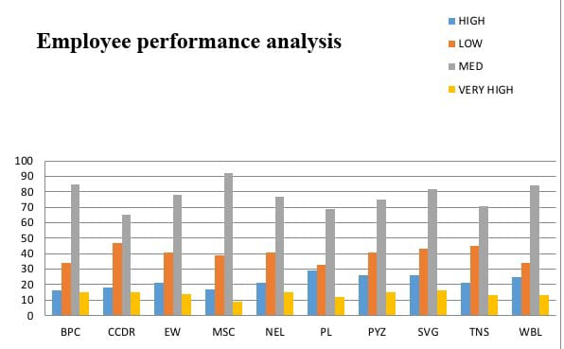
RESULTS
11

Slide 12
conclusion
The conclusion section of an employee performance analysis using Excel should summarize the key insights, evaluate the effectiveness of the analysis, and provide a clear path forward.

